Slide 1


Asia Pacific College
Disaster Response
Bueno | Belchez | Malapo | Mortera

Slide 2
Law and Order
Bueno | Belchez | Malapo | Mortera

Slide 3
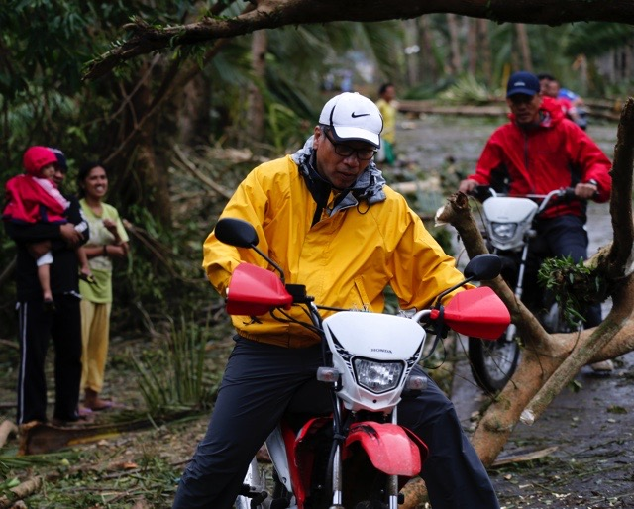

Law and Order
MISSION: To ensure that peace and order will be upheld during disaster
LEAD AGENCY: Philippine National Police

Slide 4





MEMBER AGENCIES:
AFP,DFA, OCD, DILG, DOH, MMDA, REACT, NBI, PRC, PNP, BFP, DPWH, PCG, IFRC, ICRC, UNDAC and Private / Volunteer Groups

Slide 5
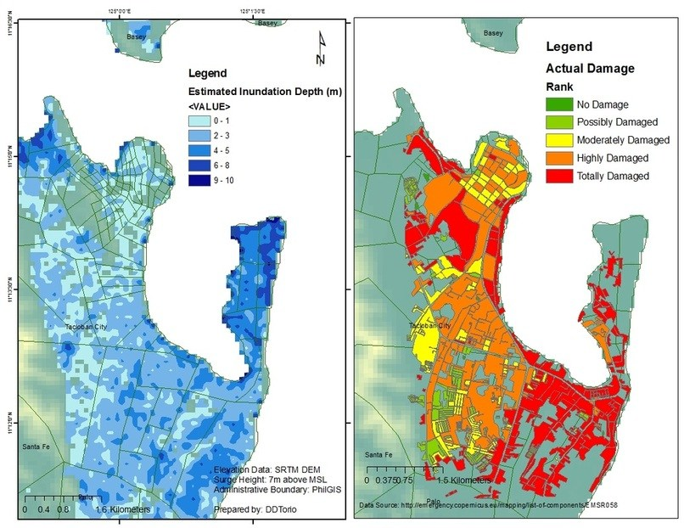
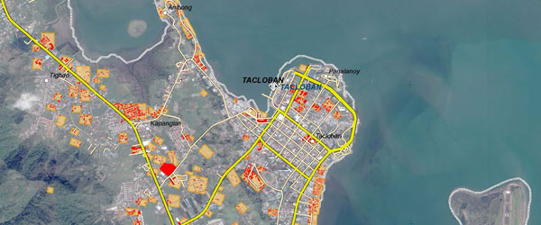
Level of Disaster

Slide 6
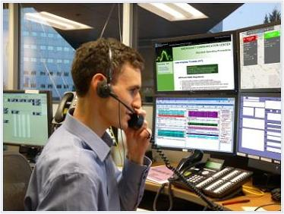
Scope
Maintain peace and order within the area
Identify the level of disaster
Send reports for future response
Communication between the respondents through messaging, call or video

Slide 7
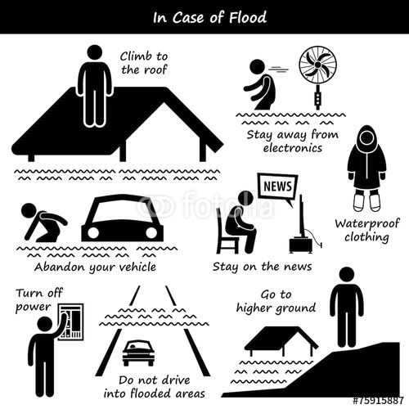
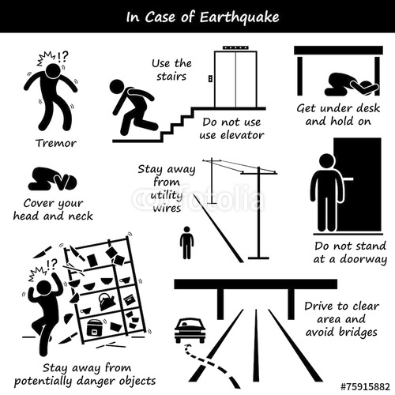
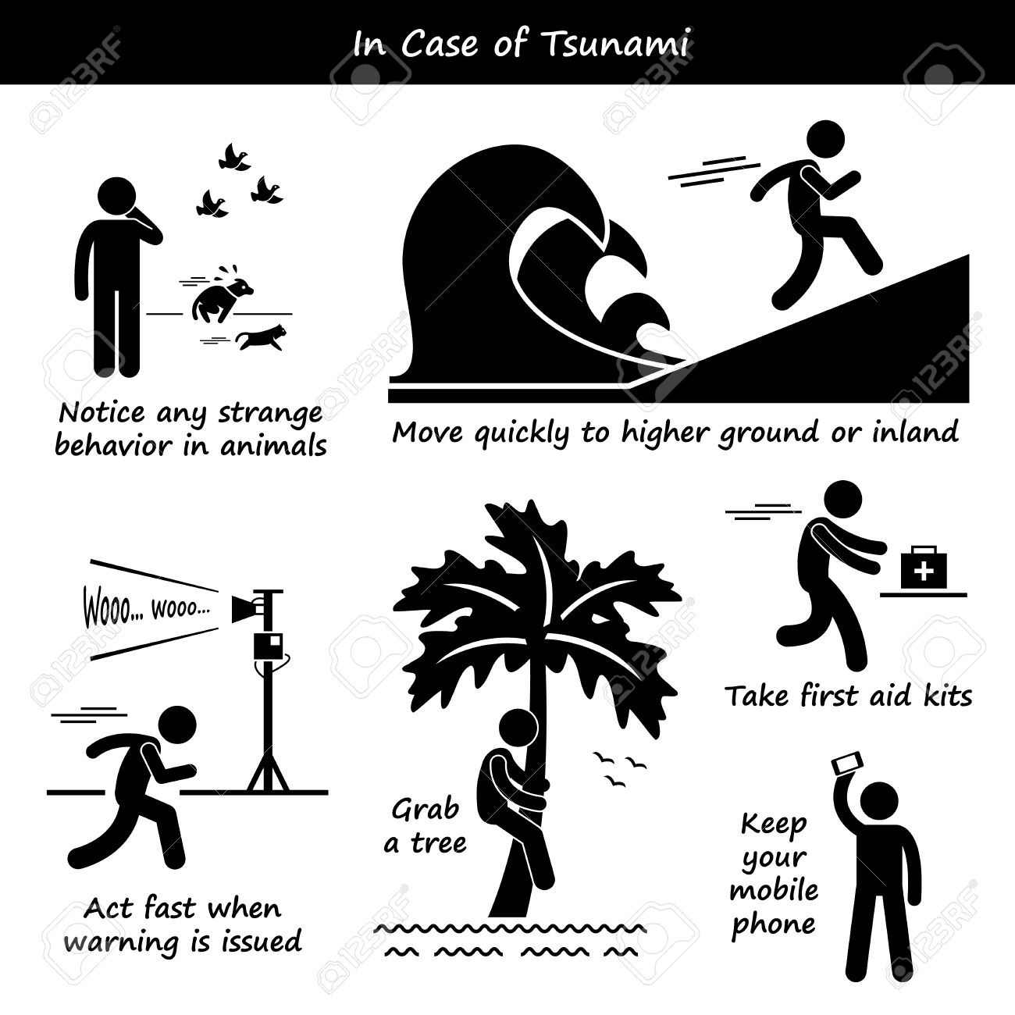
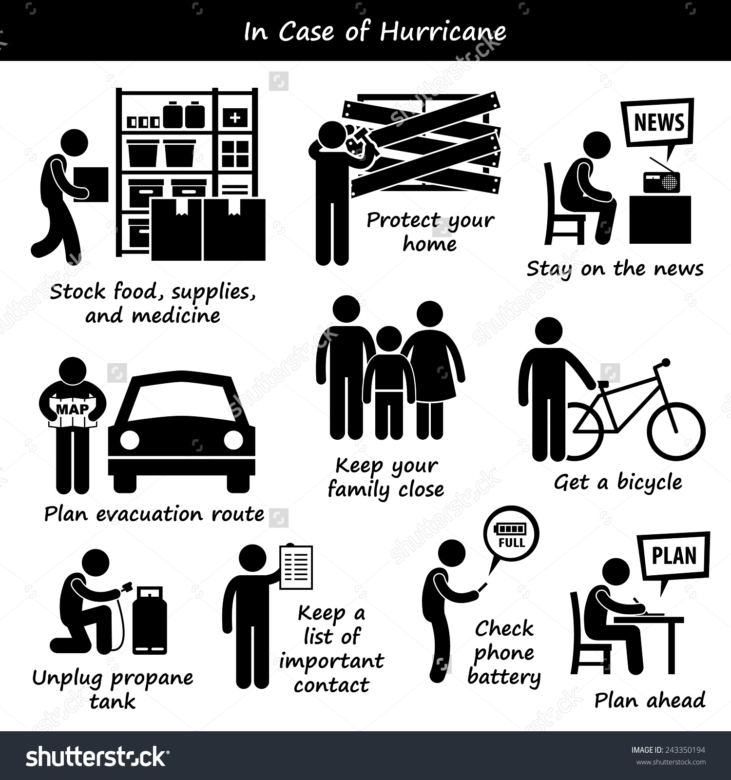
Drills

Slide 8
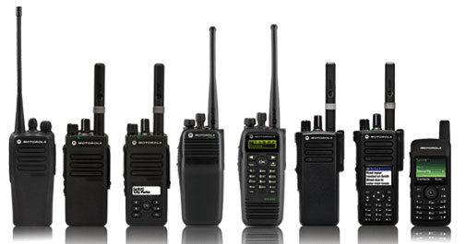
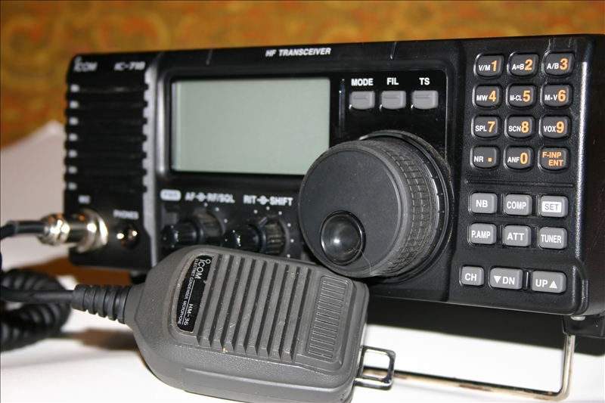
Communication Devices

Slide 9
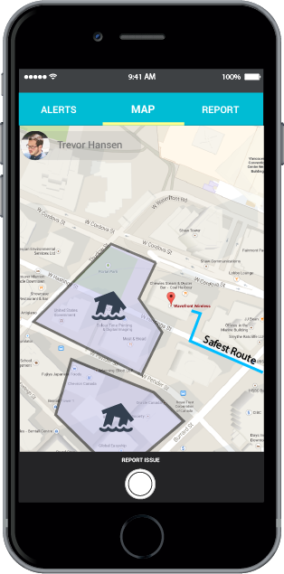
Command and Response APP
A proprietary mobile app which uses wireless mesh networking (Bluetooth or Wifi) to enable smartphones communicate even without network or Internet connection.

Slide 10
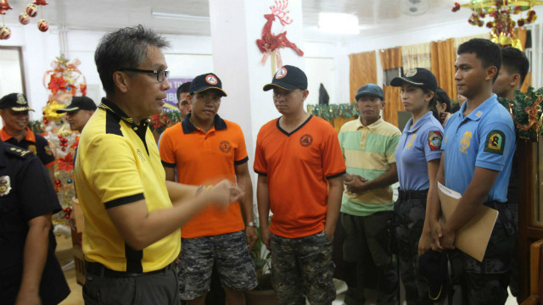
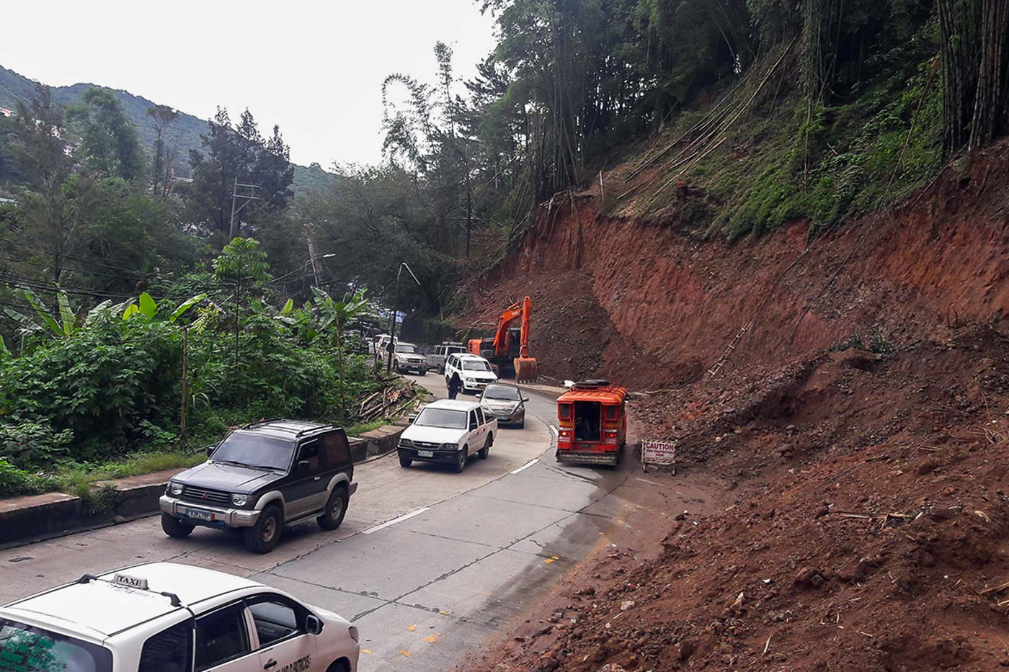
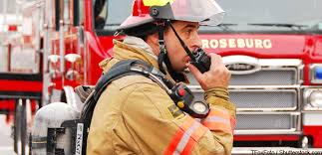
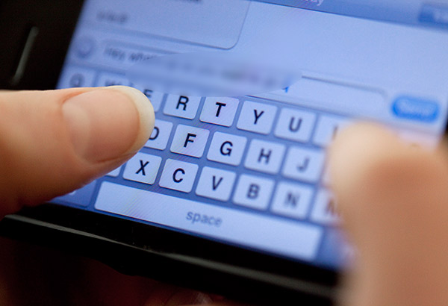
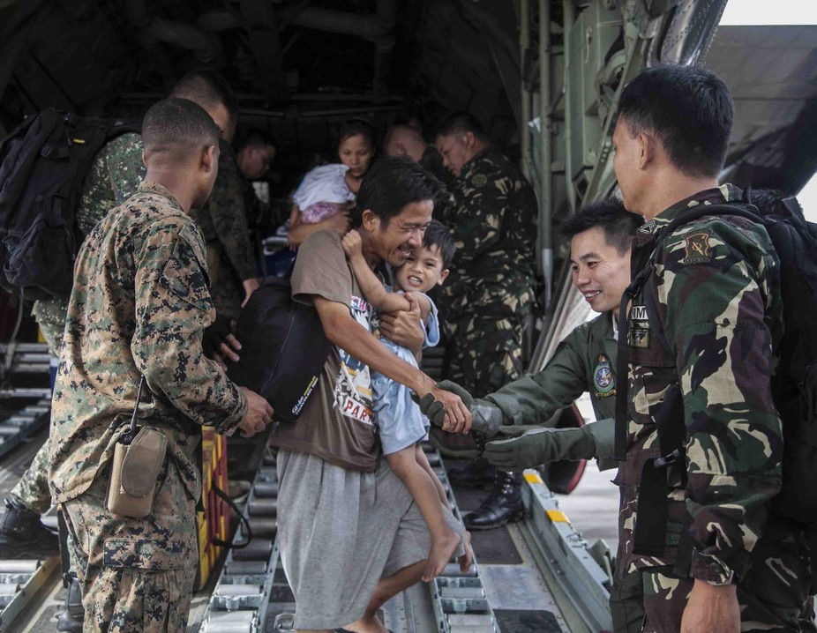
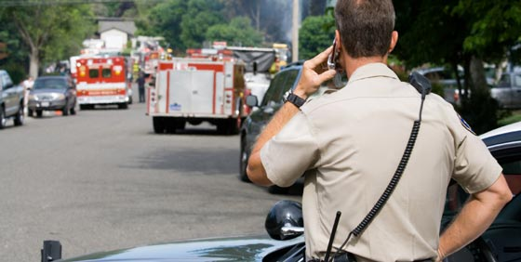
TRANSMIT REPORTS / COMMANDS

Slide 11
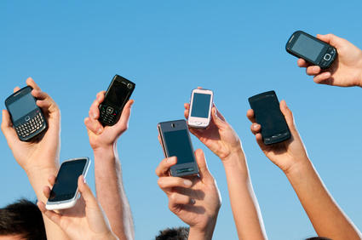
Requirements & Specifications
Mobile Device (API 16 up to latest)
Bluetooth or Wifi Connectivity

Slide 12
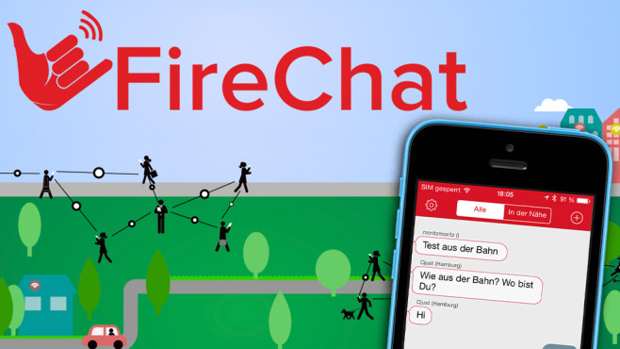
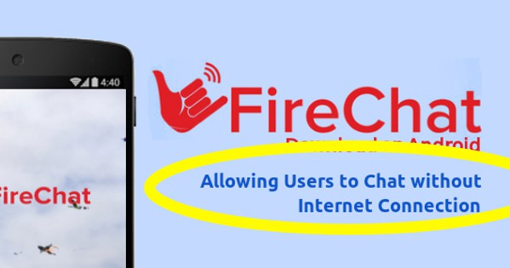
Similar APP

Slide 13
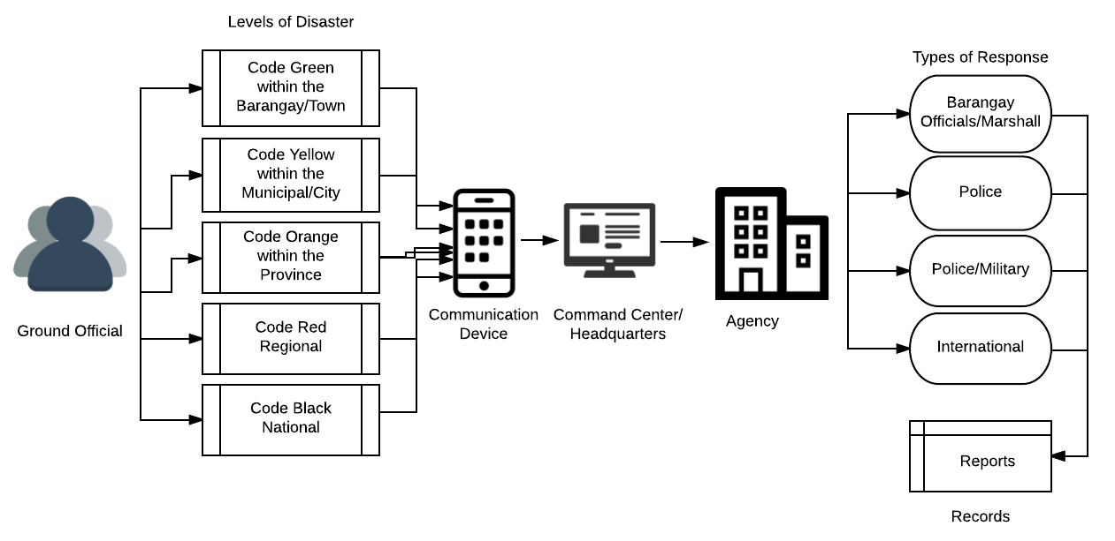
Conceptual Framework Diagram

Slide 14
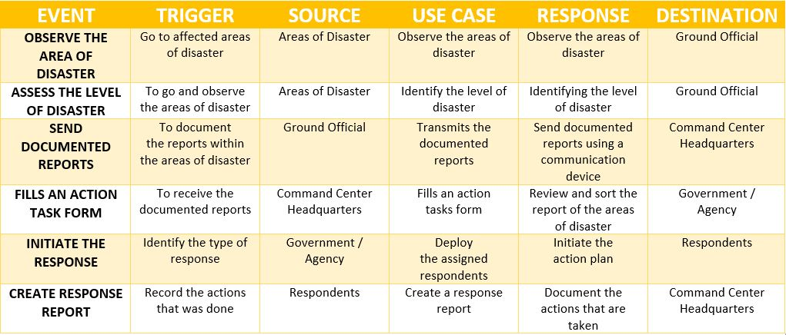
Event Table

Slide 15
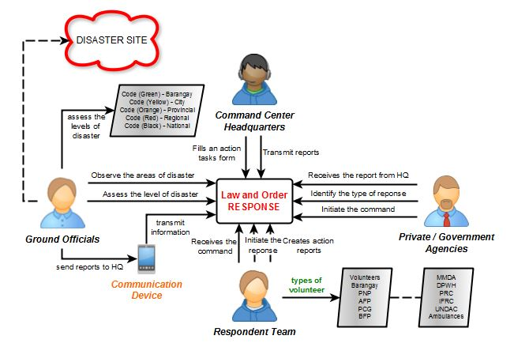
Context Flow Diagram

Slide 16
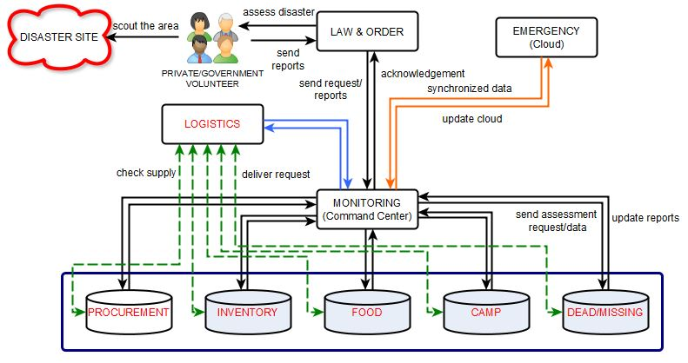
Hierarchy Diagram

Slide 17
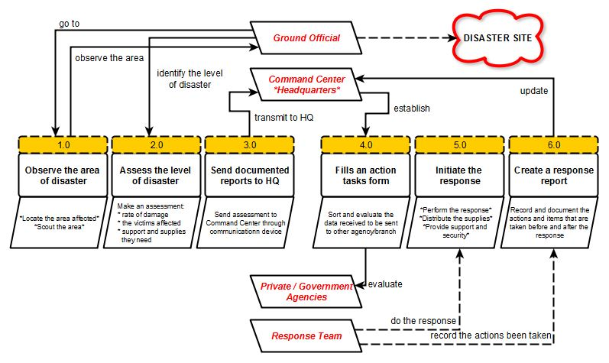
Data Flow Diagram

Slide 18
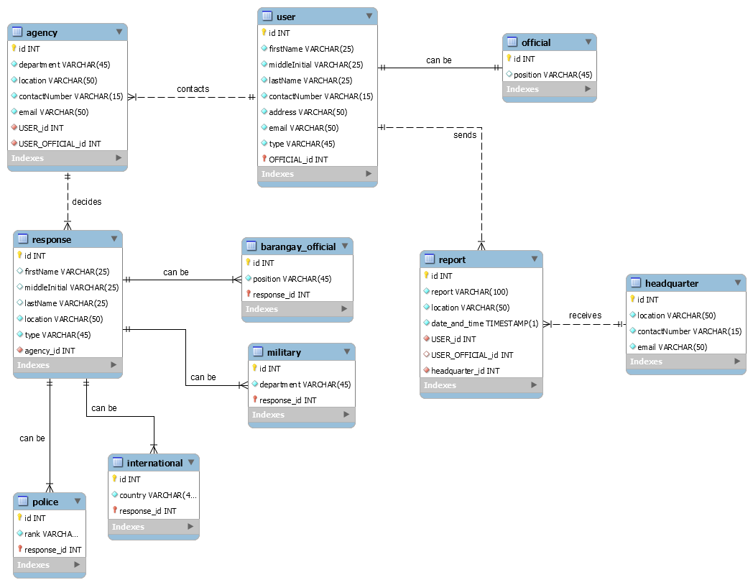
Entity-Relationship Diagram

Slide 19
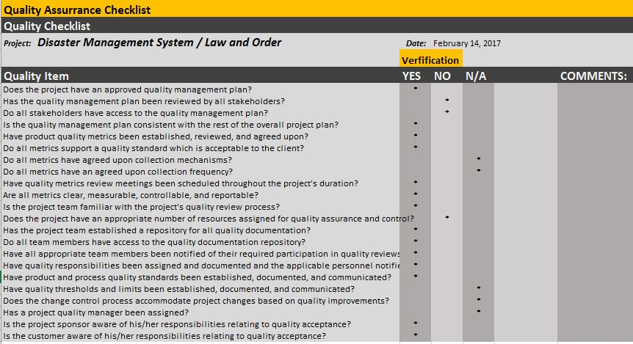
Quality Assurance Checklist

Slide 20
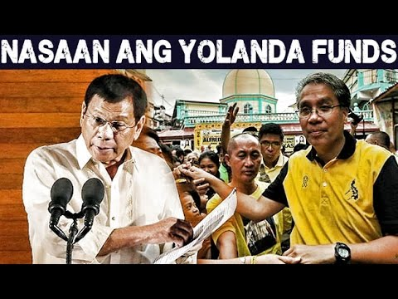
Law and Order

